Slide 1
React Fundamentals
May 5, 2017
Limited Access

Slide 2
Agenda
Overview
Architecture
Components
Handling Event
Forms
Performance

Slide 3
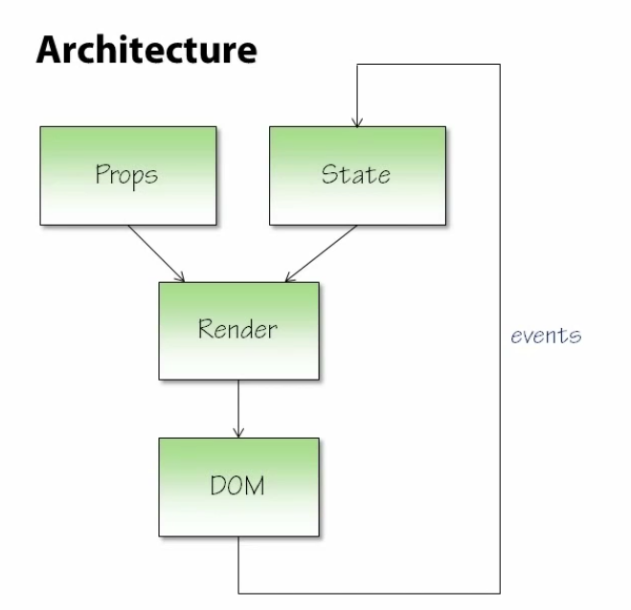
Architecture

Slide 4
Components
JSX
const element = <h1>Hello World!</h1>
Rendering Elements
Life Cycle
Mounting
constructor()
componentWillMount()
render()
componentDidMount()
Updating
componentWillReceiveProps() // get new props
shouldComponentUpdate()
componentWillUpdate()
render()
componentDidUpdate()
UnMounting
componentWillUnmount()

Slide 5
Handling Event
React vs. DOM
React use camelCase, DOM use lowercase
JSX with function, DOM with string
React call e.preventDefault(), DOM return false
Bind ‘this’
Ref

Slide 6
Forms
Controlled Components Form

Slide 7
Performance

Slide 8
Q&A?

